Slide 1
MinRank and its Application to Cryptanalysis
Survey talk by Ray Perlner
Ray.Perlner@nist.gov
National Institute of Standards and Technology (US)

Slide 2
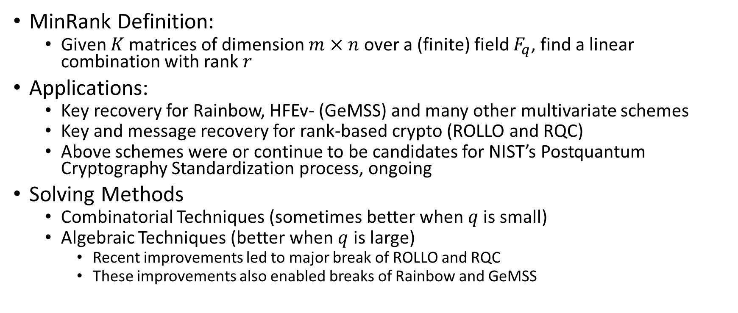
About Minrank
MinRank Definition:
  Given $K$ matrices of dimension $m×n$ over a (finite) field $F_{q}$, find a linear combination with rank $r$
Applications:
  Key recovery for Rainbow, HFEv- (GeMSS) and many other multivariate schemes
  Key and message recovery for rank-based crypto (ROLLO and RQC)
  Above schemes were or continue to be candidates for NIST’s Postquantum Cryptography Standardization process, ongoing
Solving Methods
  Combinatorial Techniques (sometimes better when $q$ is small)
  Algebraic Techniques (better when $q$ is large)
    Recent improvements led to major break of ROLLO and RQC
    These improvements also enabled breaks of Rainbow and GeMSS

Slide 3
Talk outline
MinRank in Code Based Crypto
  Rank Syndrome Decoding (RSD) Variant
Solving techniques
  Combinatorial Techniques
  Algebraic Techniques
  Support Minors Modeling
Other recent developments in MinRank

Slide 4
MinRank in Code Based Crypto
Rank Metric Codes

Slide 5

Rank Metric
Applies to vectors over $GF\left(q^{m}\right)$
Use a basis over $GF(q)$ to rewrite an $n$-dimensional vector over $GF\left(q^{m}\right)$ as an $n×m$ matrix over $GF(q)$
  Compute the rank
E.g. under the basis $(1,x,x^{2})$ for $GF(2^{3})$:
$$(1+x,0,1+x^{2},1+x,x^{2}+x)$$
Becomes
$$\left(\begin{matrix}\begin{matrix}\begin{matrix}1 \\ 1 \\ 0\end{matrix} & \begin{matrix}0 \\ 0 \\ 0\end{matrix}\end{matrix} & \begin{matrix}\begin{matrix}1 \\ 0 \\ 1\end{matrix} & \begin{matrix}1 \\ 1 \\ 0\end{matrix} & \begin{matrix}0 \\ 1 \\ 1\end{matrix}\end{matrix}\end{matrix}\right)$$
Which has rank 2

Slide 6
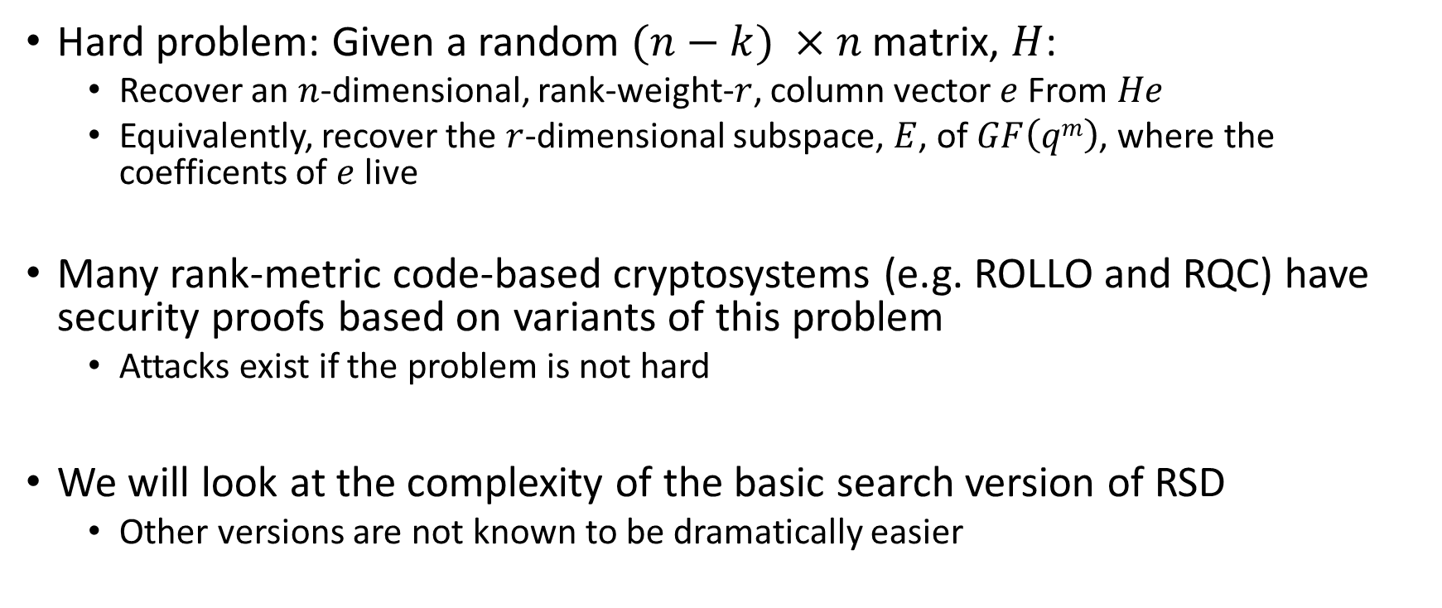
Rank Syndrome Decoding (RSD)
Hard problem: Given a random $(n−k) ×n$ matrix, $H$:
  Recover an $n$-dimensional, rank-weight-$r$, column vector $e$ From $He$
  Equivalently, recover the $r$-dimensional subspace, $E$, of $GF\left(qm\right)$, where the coefficents of $e$ live
Many rank-metric code-based cryptosystems (e.g. ROLLO and RQC) have security proofs based on variants of this problem
  Attacks exist if the problem is not hard
We will look at the complexity of the basic search version of RSD
  Other versions are not known to be dramatically easier

Slide 7
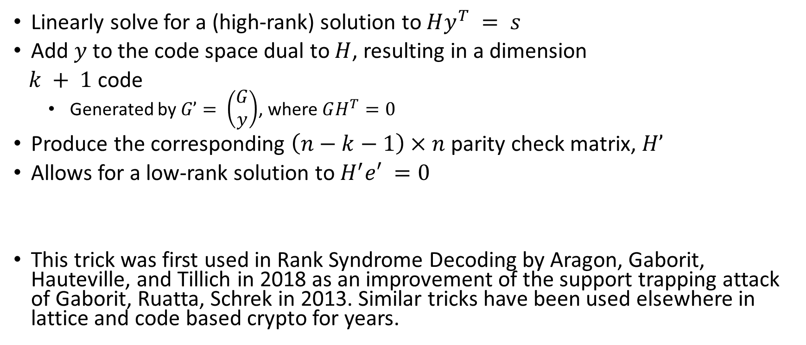
RSD as Low-Rank Codeword Search
Linearly solve for a (high-rank) solution to $Hy^{T} = s$
Add $y$ to the code space dual to $H$, resulting in a dimension
$k + 1$code
  Generated by $G’= \left(\begin{matrix}G \\ y\end{matrix}\right)$, where $GH^{T}=0$
Produce the corresponding $\left(n−k−1\right)×n$ parity check matrix, $H’$
Allows for a low-rank solution to $H^{′}e′ =0$
This trick was first used in Rank Syndrome Decoding by Aragon, Gaborit, Hauteville, and Tillich in 2018 as an improvement of the support trapping attack of Gaborit, Ruatta, Schrek in 2013. Similar tricks have been used elsewhere in lattice and code based crypto for years.

Slide 8
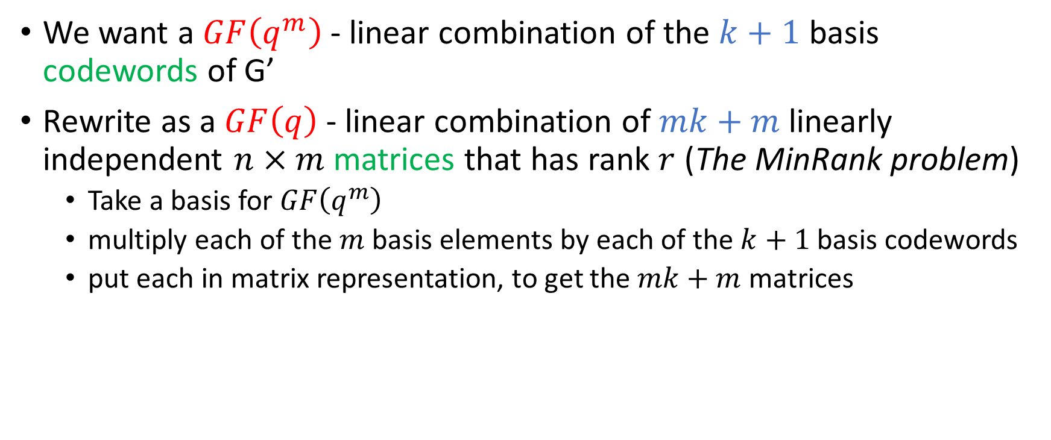
Rank Syndrome Decoding as MinRank
We want a $GF\left(q^{m}\right)$ - linear combination of the $k+1$ basis codewords of G’
Rewrite as a $GF\left(q\right)$ - linear combination of $mk+m$ linearly independent $n×m$matrices that has rank $r$ (The MinRank problem)
  Take a basis for $GF\left(q^{m}\right)$
  multiply each of the $m$ basis elements by each of the $k+1$basis codewords
  put each in matrix representation, to get the $mk+m$ matrices

Slide 9
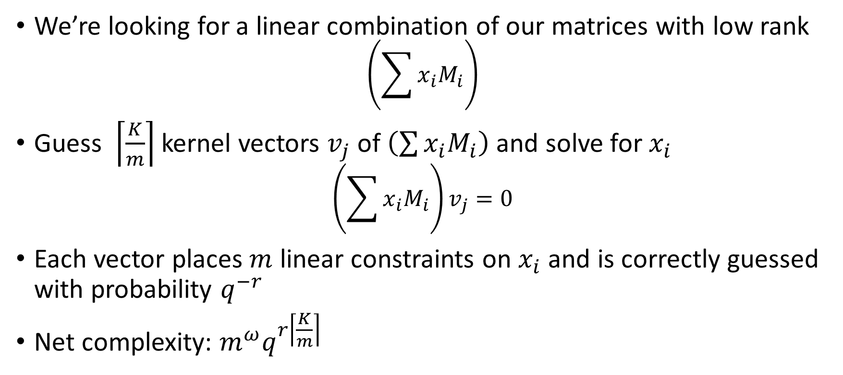
Combinatorial Techniques: Example –
Linear Algebra Search [Goubin, Courtois 2000]
We’re looking for a linear combination of our matrices with low rank
$$\left(\sum{x_{i}M_{i}}\right)$$
Guess $\left\lceil \frac{K}{m}\right\rceil$ kernel vectors $v_{j}$ of $\left(\sum{x_{i}M_{i}}\right)$ and solve for $x_{i}$
$$\left(\sum{x_{i}M_{i}}\right)v_{j}=0$$
Each vector places $m$ linear constraints on $x_{i}$ and is correctly guessed with probability $q^{−r}$
Net complexity: $m^{ω}q^{r\left\lceil \frac{K}{m}\right\rceil }$

Slide 10
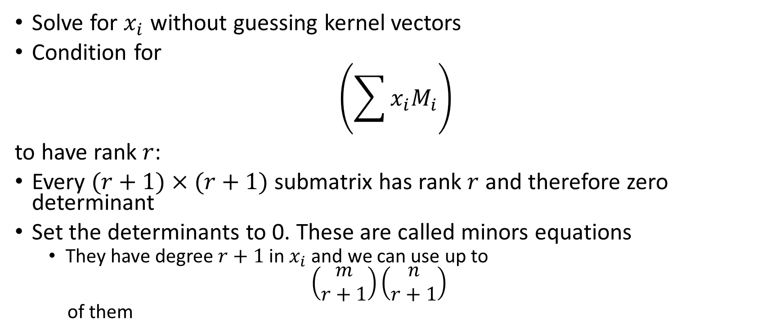
Algebraic Techniques: Example – Minors Modeling
[Bettale, Faugère, Perret 2013]
Solve for $x_{i}$ without guessing kernel vectors
Condition for
$$\left(\sum{x_{i}M_{i}}\right)$$
to have rank $r$:
Every $(r+1)×(r+1)$ submatrix has rank $r$ and therefore zero determinant
Set the determinants to 0. These are called minors equations
  They have degree $r+1$ in $x_{i}$ and we can use up to
  $$\left(\begin{matrix}m \\ r+1\end{matrix}\right)\left(\begin{matrix}n \\ r+1\end{matrix}\right)$$
  of them

Slide 11
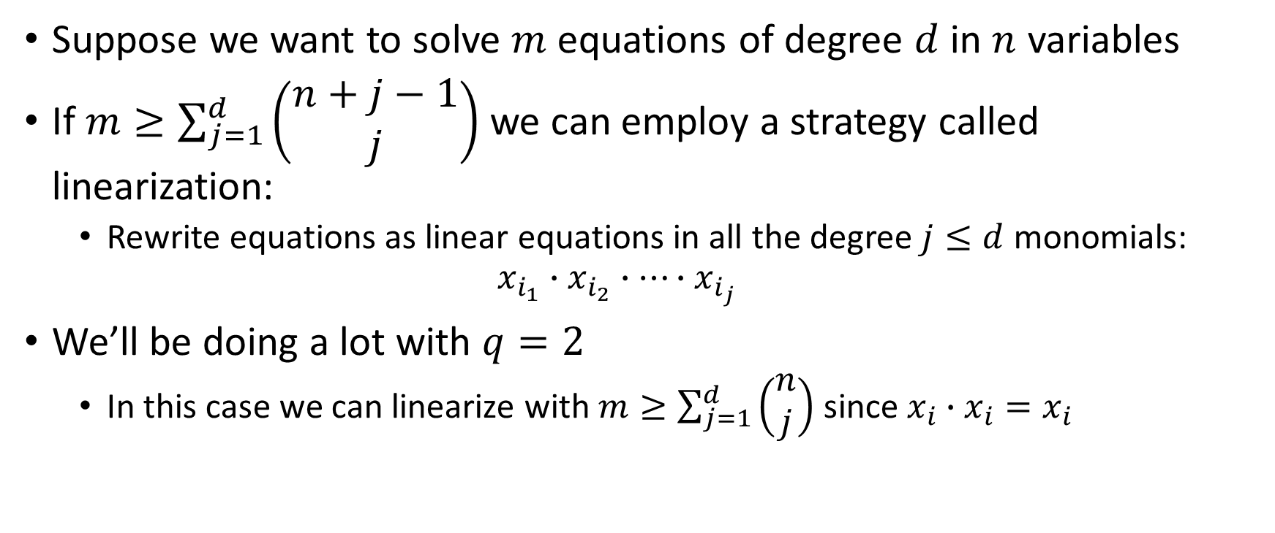
Solving polynomial systems
General strategy: Linearization
Suppose we want to solve $m$ equations of degree $d$ in $n$ variables
If $m≥\sum_{j=1}^{d}{\left(\begin{matrix}n+j−1 \\ j\end{matrix}\right)}$ we can employ a strategy called linearization:
  Rewrite equations as linear equations in all the degree $j≤d$ monomials:
  $$x_{i_{1}}∙x_{i_{2}}∙…∙x_{i_{j}}$$
We’ll be doing a lot with $q=2$
  In this case we can linearize with $m≥\sum_{j=1}^{d}{\left(\begin{matrix}n \\ j\end{matrix}\right)}$ since $x_{i}∙$ $x_{i}=x_{i}$

Slide 12
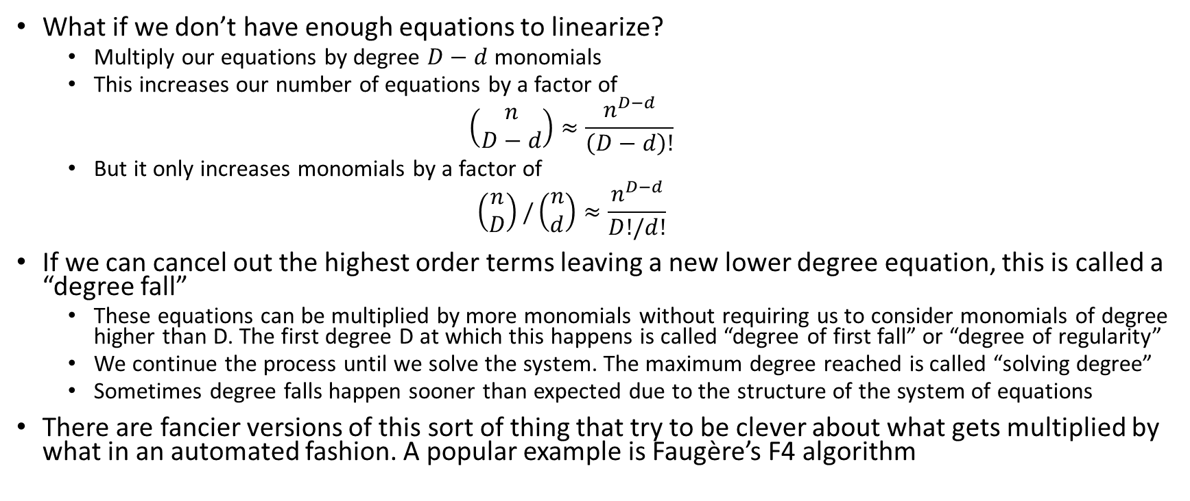
Extended Linearization (XL)
(and other Gröbner basis techniques)
What if we don’t have enough equations to linearize?
  Multiply our equations by degree $D−d$ monomials
  This increases our number of equations by a factor of
  $$\left(\begin{matrix}n \\ D−d\end{matrix}\right)≈\frac{n^{D−d}}{\left(D−d\right)!}$$
  But it only increases monomials by a factor of
  $$\left(\begin{matrix}n \\ D\end{matrix}\right)/\left(\begin{matrix}n \\ d\end{matrix}\right)≈\frac{n^{D−d}}{D!/d!}$$
If we can cancel out the highest order terms leaving a new lower degree equation, this is called a “degree fall”
  These equations can be multiplied by more monomials without requiring us to consider monomials of degree higher than D. The first degree D at which this happens is called “degree of first fall” or “degree of regularity”
  We continue the process until we solve the system. The maximum degree reached is called “solving degree”
  Sometimes degree falls happen sooner than expected due to the structure of the system of equations
There are fancier versions of this sort of thing that try to be clever about what gets multiplied by what in an automated fashion. A popular example is Faugère’s F4 algorithm

Slide 13
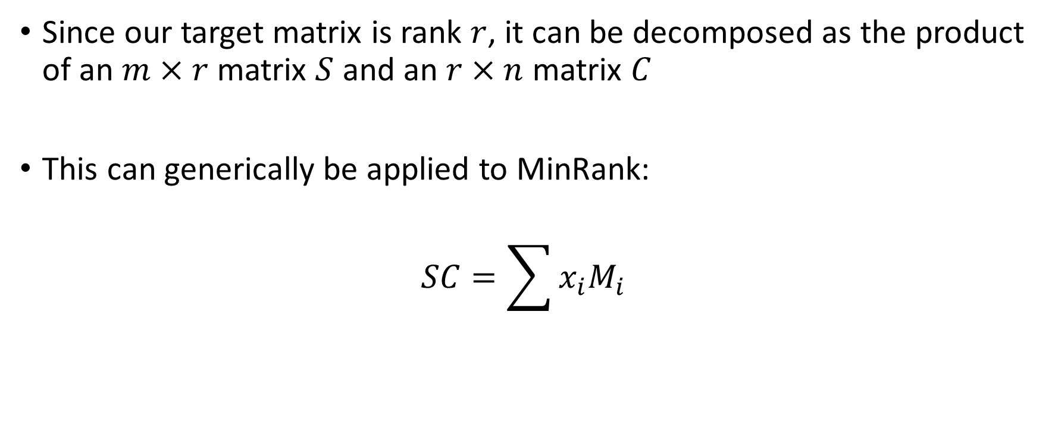
Rank Decomposition Modeling
[Bardet, Bros, Cabarcas, Gaborit, Perlner, Smith-Tone, Tillich, Verbel 2020]
Since our target matrix is rank $r$, it can be decomposed as the product of an $m×r$ matrix $S$ and an $r×n$ matrix $C$
This can generically be applied to MinRank:
$$SC=\sum{x_{i}M_{i}}$$

Slide 14
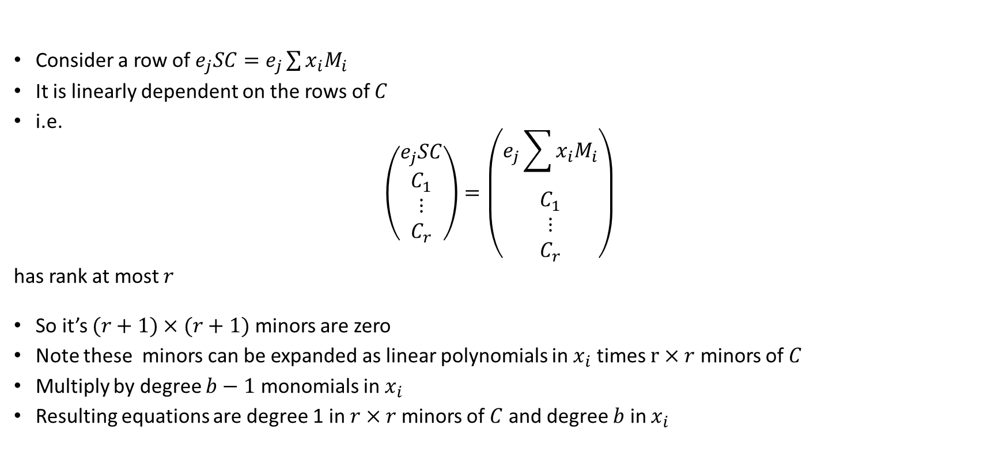
Support Minors Modeling
[Bardet, Bros, Cabarcas, Gaborit, Perlner, Smith-Tone, Tillich, Verbel 2020]
Consider a row of $e_{j}SC=e_{j}\sum{x_{i}M_{i}}$
It is linearly dependent on the rows of $C$
i.e.
$$\left(\begin{matrix}\begin{matrix}e_{j}SC \\ C_{1}\end{matrix} \\ \begin{matrix}⋮ \\ C_{r}\end{matrix}\end{matrix}\right)=\left(\begin{matrix}\begin{matrix}e_{j}\sum{x_{i}M_{i}} \\ C_{1}\end{matrix} \\ \begin{matrix}⋮ \\ C_{r}\end{matrix}\end{matrix}\right)$$
has rank at most $r$
So it’s $(r+1)×(r+1)$ minors are zero
Note these minors can be expanded as linear polynomials in $x_{i}$ times $r×r$ minors of $C$
Multiply by degree $b−1$ monomials in $x_{i}$
Resulting equations are degree 1 in $r×r$minors of $C$ and degree $b$ in $x_{i}$

Slide 15

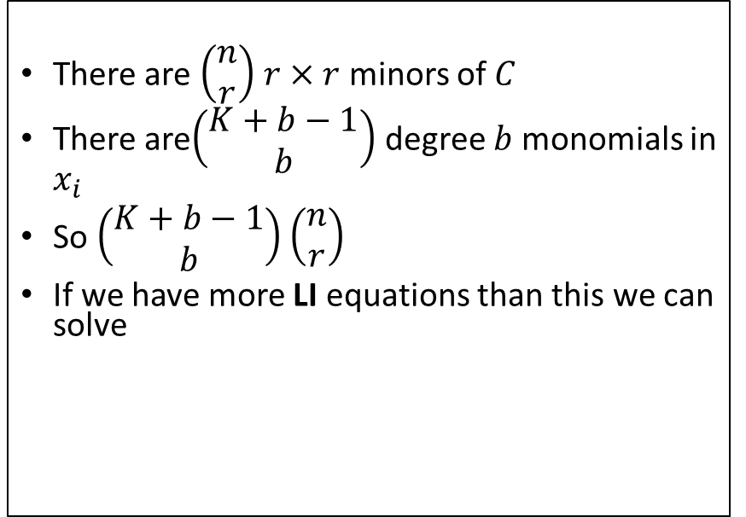
Support Minors Modeling – How Many:
Monomials?
Linearly Independent (LI) Equations?
There are $\left(\begin{matrix}n \\ r\end{matrix}\right)$ $r×r$ minors of $C$
There are$\left(\begin{matrix}K+b−1 \\ b\end{matrix}\right)$ degree $b$ monomials in $x_{i}$
So $\left(\begin{matrix}K+b−1 \\ b\end{matrix}\right)$ $\left(\begin{matrix}n \\ r\end{matrix}\right)$
If we have more LI equations than this we can solve
$$\sum_{i=1}^{b}{({−1)}^{i−1}\left(\begin{matrix}n \\ r+i\end{matrix}\right)\left(\begin{matrix}m+i−1 \\ i\end{matrix}\right)\left(\begin{matrix}K+b−i−1 \\ b−i\end{matrix}\right)}$$
Note: this formula only works when
$b<r+2$
  Read the paper to see why
Formula extensively tested with experiments
  can it be proven?
When we have more LI equations than monomials, we can solve!

Slide 16
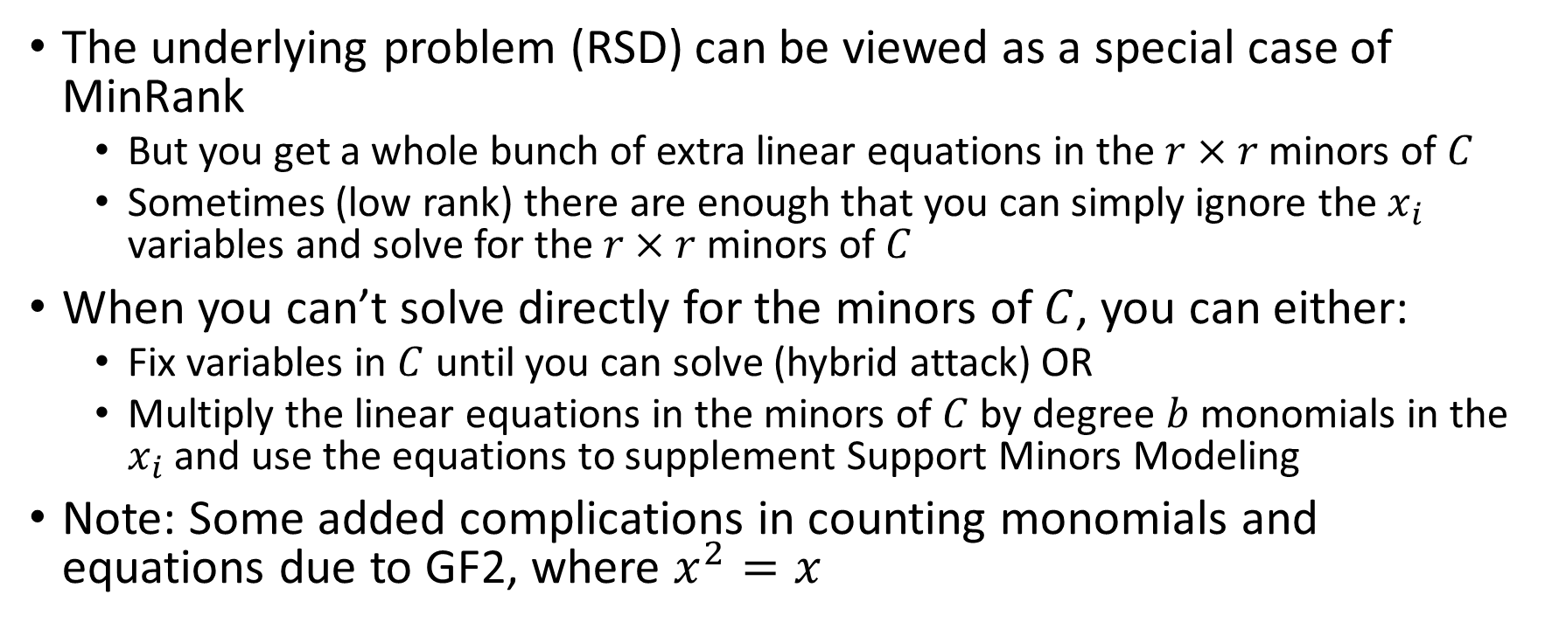
Application to Rank-Based Crypto
(ROLLO, RQC)
The underlying problem (RSD) can be viewed as a special case of MinRank
  But you get a whole bunch of extra linear equations in the $r×r$minors of $C$
  Sometimes (low rank) there are enough that you can simply ignore the $x_{i}$ variables and solve for the $r×r$minors of $C$
When you can’t solve directly for the minors of $C$, you can either:
  Fix variables in $C$ until you can solve (hybrid attack) OR
  Multiply the linear equations in the minors of $C$ by degree $b$ monomials in the $x_{i}$ and use the equations to supplement Support Minors Modeling
Note: Some added complications in counting monomials and equations due to GF2, where $x^{2}=x$

Slide 17
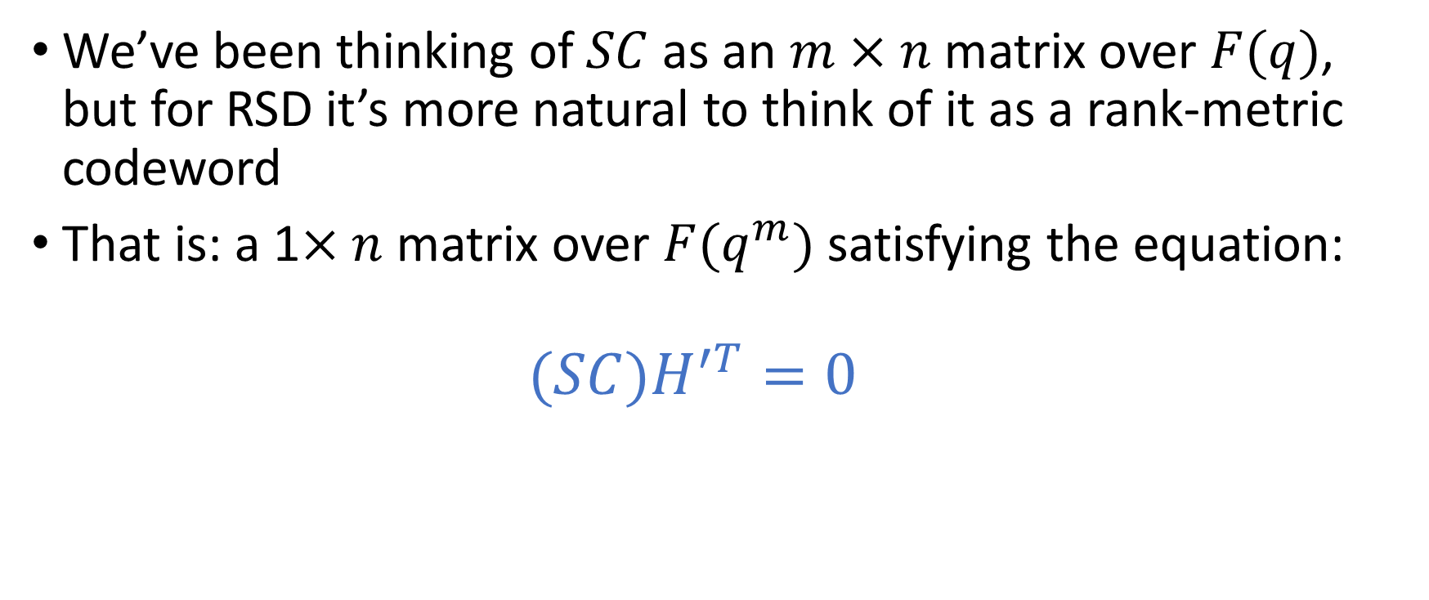
Extra equations for RSD 1: Syndrome Modeling
[Bardet, Briaud, Bros, Gaborit, Neiger, Ruatta, Tillich 2019]
We’ve been thinking of $SC$ as an $m×n$ matrix over $F(q)$, but for RSD it’s more natural to think of it as a rank-metric codeword
That is: a 1$×n$ matrix over $F(q^{m})$ satisfying the equation:
  $$(SC)H^{′T}=0$$

Slide 18
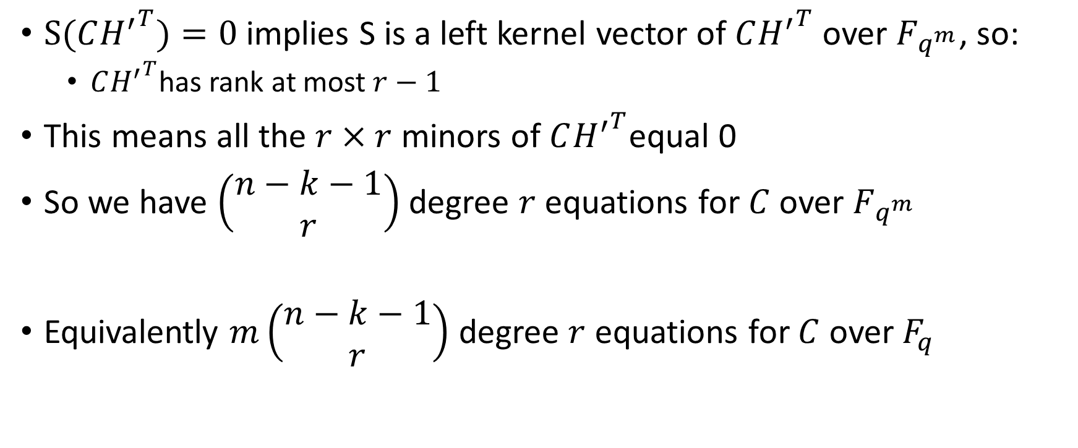

Extra equations for RSD 2:
MaxMinors($C{H′}^{T}$)
$S(C{H^{′}}^{T})=0$ implies S is a left kernel vector of $C{H^{′}}^{T}$ over $F_{q^{m}}$, so:
  $C{H^{′}}^{T}$has rank at most $r−1$
This means all the $r×r$ minors of $C{H^{′}}^{T}$equal 0
So we have $\left(\begin{matrix}n−k−1 \\ r\end{matrix}\right)$ degree $r$ equations for $C$ over $F_{q^{m}}$
Equivalently $m\left(\begin{matrix}n−k−1 \\ r\end{matrix}\right)$ degree $r$ equations for $C$ over $F_{q}$

Slide 19
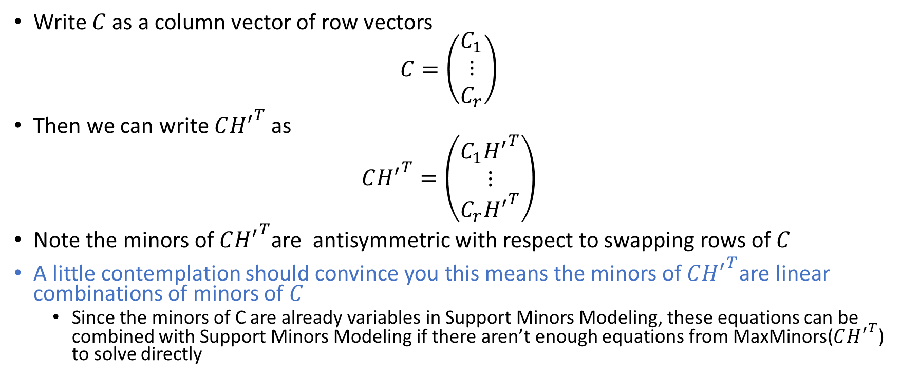

Extra equations for RSD 3:
How to use MaxMinors($C{H^{′}}^{T}$) to solve for $C$
Write $C$ as a column vector of row vectors
$$C=\left(\begin{matrix}C_{1} \\ ⋮ \\ C_{r}\end{matrix}\right)$$
Then we can write $C{H^{′}}^{T}$ as
$$C{H^{′}}^{T}=\left(\begin{matrix}C_{1}{H^{′}}^{T} \\ ⋮ \\ C_{r}{H^{′}}^{T}\end{matrix}\right)$$
Note the minors of $C{H^{′}}^{T}$are antisymmetric with respect to swapping rows of $C$
A little contemplation should convince you this means the minors of$C{H^{′}}^{T}$are linear combinations of minors of $C$
  Since the minors of C are already variables in Support Minors Modeling, these equations can be combined with Support Minors Modeling if there aren’t enough equations from MaxMinors($C{H^{′}}^{T}$) to solve directly

Slide 20

Support Minors + MaxMinors($C{H^{′}}^{T}$)
Quantitatively
This attack approach approximately halved the bits of security provided by ROLLO and RQC
Tables from [Bardet, Bros, Cabarcas, Gaborit, Perlner, Smith-Tone, Tillich, Verbel 2020]

Slide 21
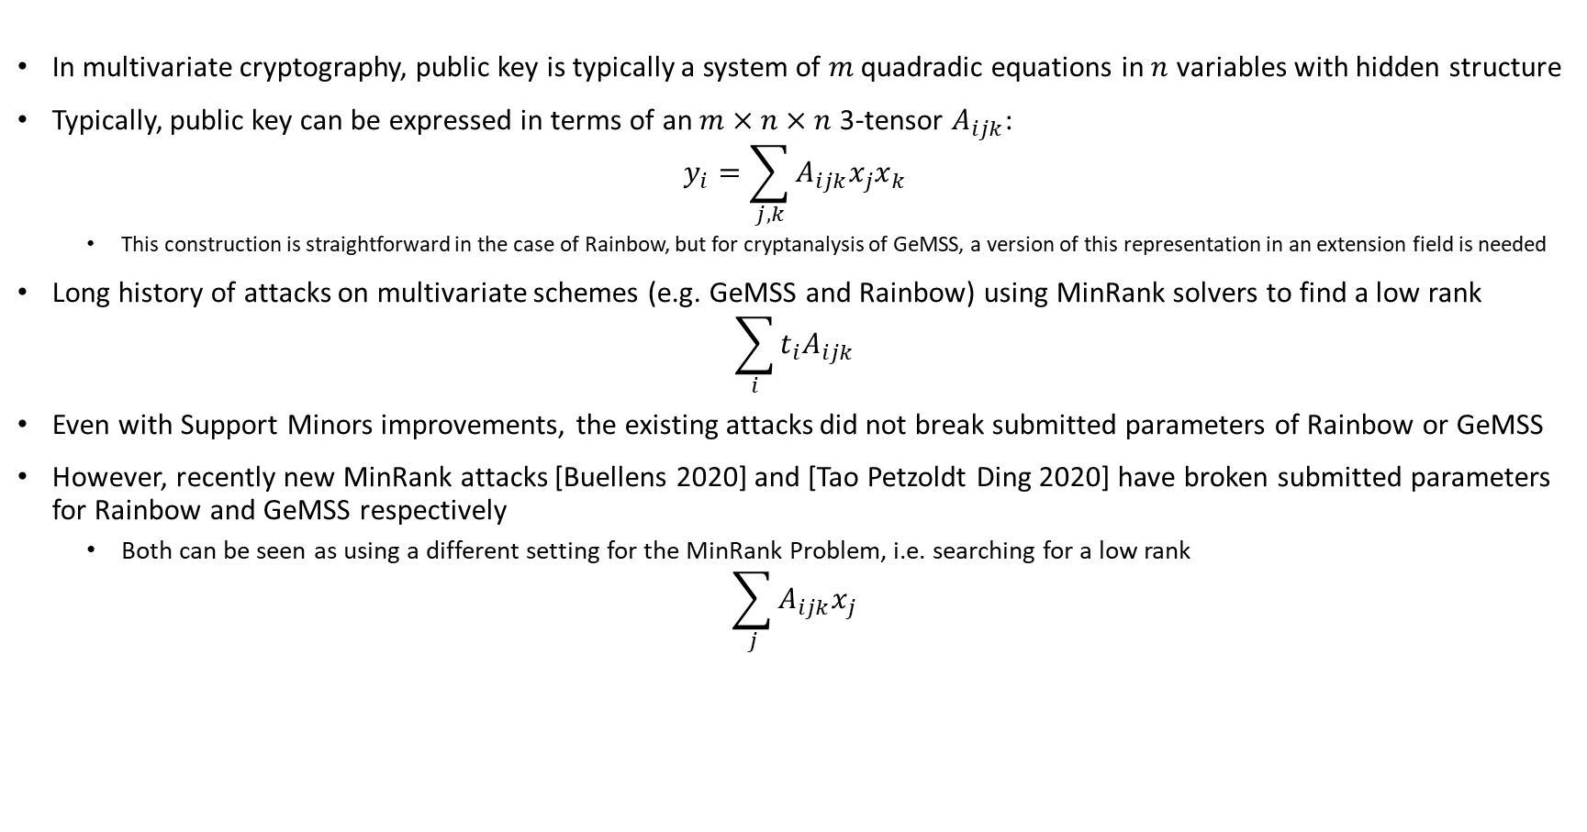
MinRank in Multivariate Cryptography
In multivariate cryptography, public key is typically a system of $m$ quadradic equations in $n$ variables with hidden structure
Typically, public key can be expressed in terms of an $m×n×n$ 3-tensor $A_{ijk}$:
$$y_{i}=\sum_{j,k}{A_{ijk}x_{j}x_{k}}$$
  This construction is straightforward in the case of Rainbow, but for cryptanalysis of GeMSS, a version of this representation in an extension field is needed
Long history of attacks on multivariate schemes (e.g. GeMSS and Rainbow) using MinRank solvers to find a low rank
$$\sum_{i}{{t_{i}A}_{ijk}}$$
Even with Support Minors improvements, the existing attacks did not break submitted parameters of Rainbow or GeMSS
However, recently new MinRank attacks [Buellens 2020] and [Tao Petzoldt Ding 2020] have broken submitted parameters for Rainbow and GeMSS respectively
  Both can be seen as using a different setting for the MinRank Problem, i.e. searching for a low rank
$$\sum_{j}{A_{ijk}x_{j}}$$

Slide 22
New Attack Complexity for Rainbow
[Buellens 2020]

Slide 23
New Attack Complexity for GeMSS
[Tao, Petzoldt, Ding 2020]

Slide 24
Conclusion
Techniques for solving MinRank have a wide variety of applications in cryptanalysis
There has been recent improvement especially in algebraic techniques for solving Minrank
Sometimes MinRank instances derived from cryptosystems have extra structure that makes them easier than generic systems
Nonetheless, MinRank appears asymptotically hard, so secure cryptosystems whose security depends on the hardness of MinRank (including more structured variants) seem possible
Recent progress suggests the need for more study!

Slide 25
Thank You!

Slide 26
References
[Goubin, Courtois 2000] Cryptanalysis of the TTM cryptosystem, Asiacrypt 2000, http://www.goubin.fr/papers/ttm.pdf
[Bettale, Faugère, Perret 2013] Cryptanalysis of HFE, multi-HFE and variants for odd and even characteristic, Designs Codes and Cryptography 2013, https://eprint.iacr.org/2011/399
[Bardet, Bros, Cabarcas, Gaborit, Perlner, Smith-Tone, Tillich, Verbel 2020] Improvements of Algebraic Attacks for Solving the Rank Decoding and MinRank Problems, Asiacrypt 2020, https://arxiv.org/abs/2002.08322
[Bardet, Briaud, Bros, Gaborit, Neiger, Ruatta, Tillich 2019] An Algebraic Attack on Rank Metric Code-Based Cryptosystems, Eurocrypt 2020, https://arxiv.org/abs/1910.00810
[Buellens 2020] Improved cryptanalysis of UOV and Rainbow, https://eprint.iacr.org/2020/1343.pdf
[Tao, Petzoldt, Ding 2020] Improved Key Recovery of the HFEv- Signature Scheme, https://eprint.iacr.org/2020/1424.pdf

